Slide 1



Customer Experience
FOB FST CX Training

Slide 2

2 Truths and a Lie

Slide 3

Objectives
At the end of this program participants will :
Understand what Customer experience is
Know who a customer is
Understand what customers want
Understand the FiberOne Customer Journey
Understand the impact of Service Delivery on Customer experience
G.U.E.S.T.
February 20, 2024
www.centumlearning.com

Slide 4
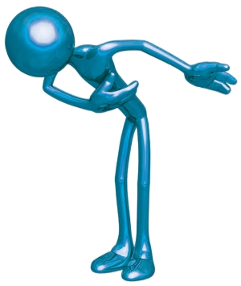



Class Rules
Thou Shall...
Work as a TEAM
Be Open to Ideas
Listen to Others
Respect your Fellow Mates
Have an Open mind
Participate; ask questions; be relevant
Respect confidentiality
Minimize distraction, turn off your cell phone

Slide 5
Who is a Customer

Slide 6

Who is a Customer

Slide 7
Customers are…
The most important part in our business
Not an interruption to our work – but the purpose of our work
Not dependent on us – we depend on them
Not just a cold statistic but flesh and blood human beings with feelings and emotions like ours
Not someone to argue or match wits with
People who bring us their wants – our job is to satisfy them
The lifeblood of every business

Slide 8

Customers are
“There is only one boss, and whether a person shines shoes for a living or heads up the biggest corporation in the world, the boss remains the same. It is the customer! The customer is the person who pays everyone’s salary and who decides whether a business is going to succeed or fail. In fact, the customer can fire everybody in the company from the chairman (CEO) on down, and he can do it simply by spending his money somewhere else.
“Literally everything we do, every concept perceived, every technology developed and associate employed, is directed with this one objective clearly in mind – pleasing the customer.”
Sam M. Walton, CEO Wal-Mart – an international chain of department stores and the most successful company in retailing in the world.

Slide 9

What do customers want?

Slide 10
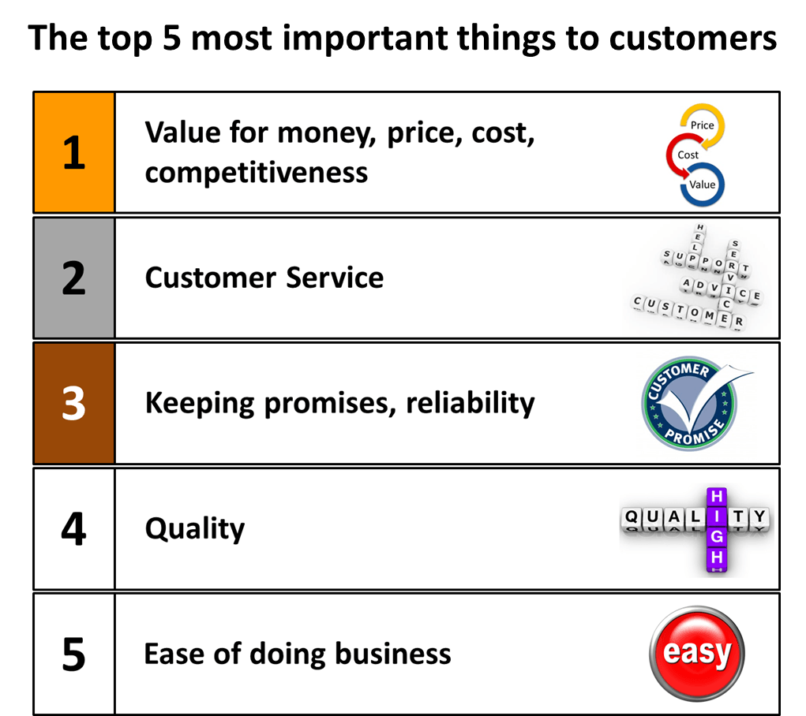
What do customers want?

Slide 11








Why should we be concerned?
In the average business, for each customer who complains there are 26 who feel the same way and don’t speak up.
The customers who feel poorly served will tell between 8 and 16 people about their negative experience.
        Technical Assistance Research, Inc.

Slide 12
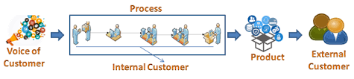
Types of Customers
Internal
External
For Customer experience to work externally, there must be Customer experience internally

Slide 13
What is Customer Experience

Slide 14
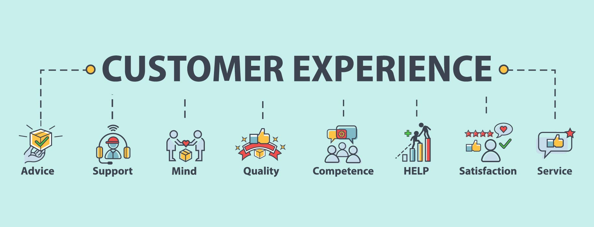
What Is CX?
G.U.E.S.T.
February 20, 2024
The Sum total of a customer's interaction across every channel of a Company and the emotions experienced dealing with the brand.
www.centumlearning.com

Slide 15
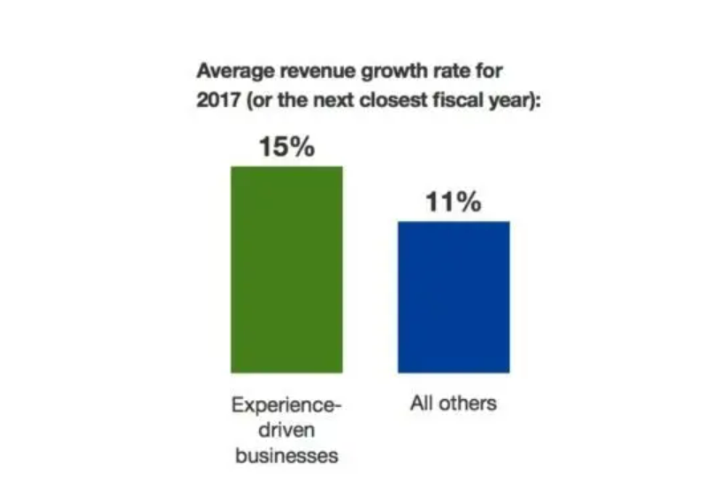
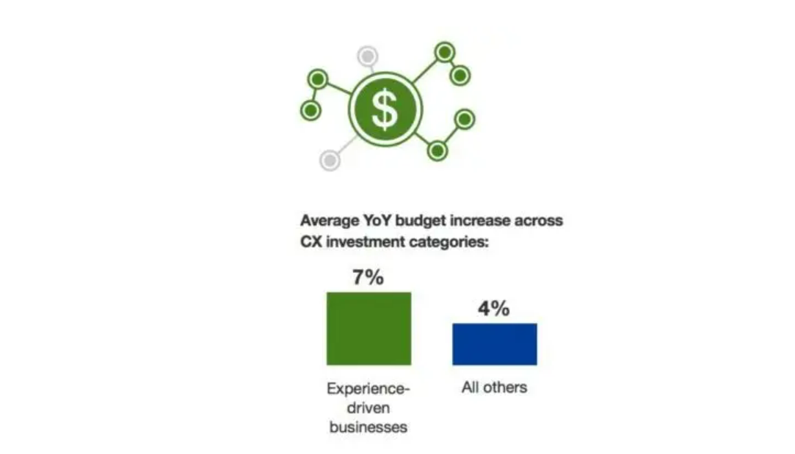
Why CX?
Experience driven businesses have 1.9x higher revenues than none Experience driven ones, but growth comes at a cost

Slide 16
The GOAL
Enjoyable (I feel good about using it)
Easy (I didn’t have to work hard)
Meet Needs
(Helped me accomplish my goals)
Brand Affinity
FOB CX Drivers
Tech Support and Installation
Contact Center Operations
Data Analytics
Organizational Culture
Processes and Policies
Ease of doing business
Customer Success
The Experience Pyramid- Where is FiberOne right now on the Pyramid?

Slide 17
FOB Customer Journey Map
Consideration
Onboarding
Retention
Customer Checks us out and finds reviews and WOM
Onboarding Welcomes and Schedules
Tech, CX, Finance, IT, Procurement and Inventory Supports
Awareness
Acquisition
Activation
Customer Finds FiberOne FiberOne finds customer
Customer deals and makes Payment
Tech Installs and Activates

Slide 18




Current State of CX
Awareness
Consideration
Acquisition
Onboarding
Service
Loyalty
Awareness
Consideration
Onboarding
Activation
Retention
Perfect
Good
Medium
Bad

Slide 19
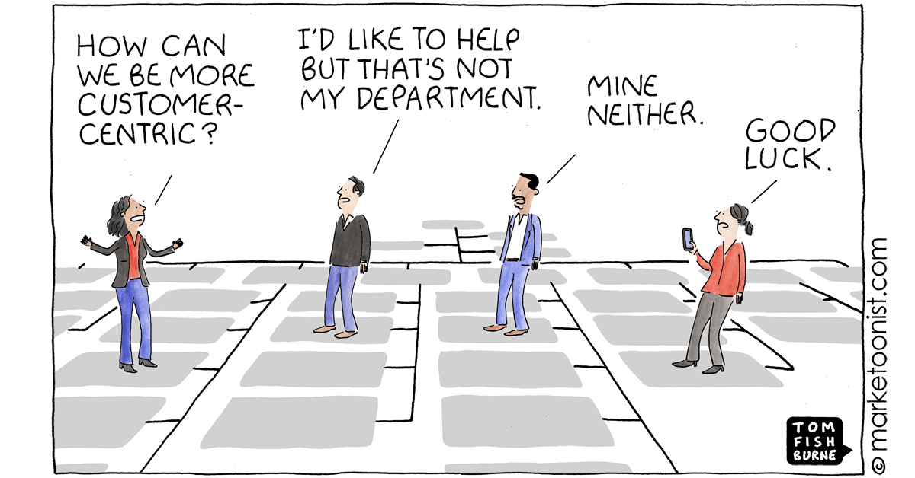
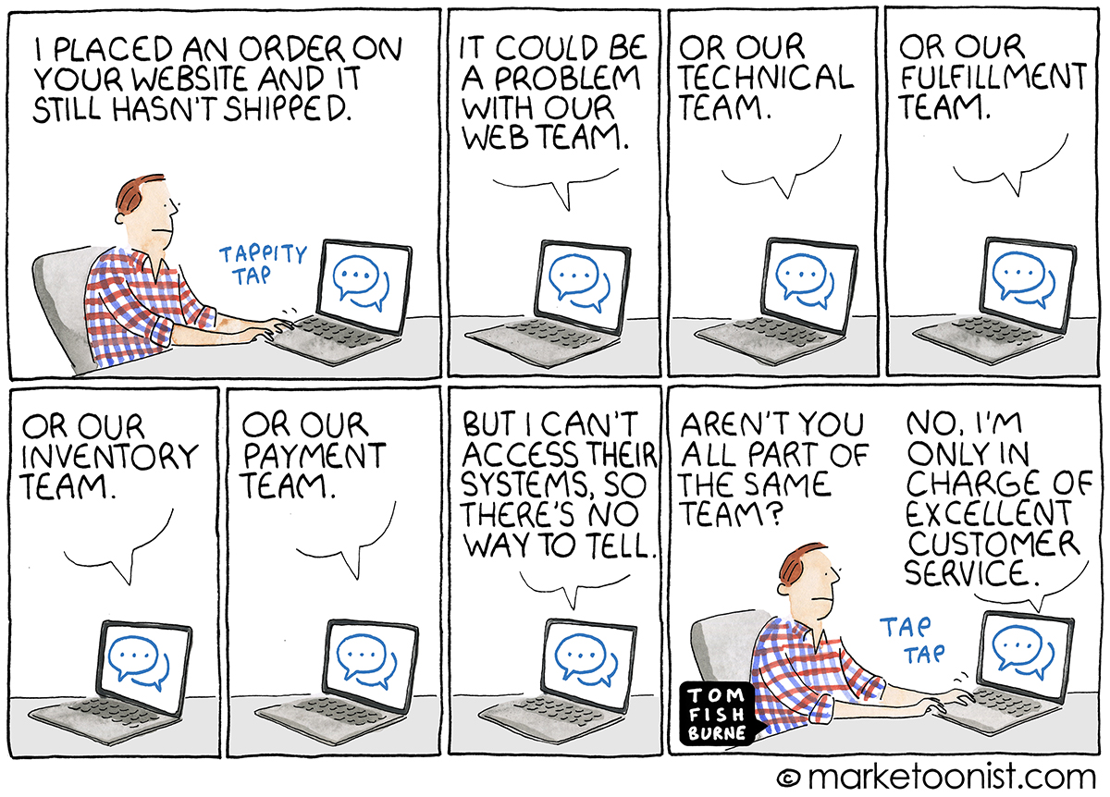
Whose Responsibility is CX?
G.U.E.S.T.
February 20, 2024
www.centumlearning.com

Slide 20
Why you are the Key
Customer Complains
CX Raises tickets and assigns to Tech
?
?
Customer expects Feedback on Resolution
?
What should happen here?
What does this lead to?
And here?
When there is no close looping (feedback and resolution) between Tech and CX, the company
loses its Customers (Churn) and Revenue
Remember what customers NEED?
www.centumlearning.com

Slide 21

Thank You

